Slide 1
Chapter 9: Virtual Memory

Slide 2
Chapter 9: Virtual Memory
Background
Demand Paging
Copy-on-Write
Page Replacement
Allocation of Frames
Thrashing
Memory-Mapped Files
Allocating Kernel Memory
Other Considerations
Operating-System Examples

Slide 3
Objectives
To describe the benefits of a virtual memory system
To explain the concepts of demand paging, page-replacement algorithms, and allocation of page frames
To discuss the principle of the working-set model
To examine the relationship between shared memory and memory-mapped files
To explore how kernel memory is managed

Slide 4
Background
Code needs to be in memory to execute, but entire program rarely used
  Error code, unusual routines, large data structures
Entire program code not needed at same time
Consider ability to execute partially-loaded program
  Program no longer constrained by limits of physical memory
  Each program takes less memory while running -> more programs run at the same time
    Increased CPU utilization and throughput with no increase in response time or turnaround time
  Less I/O needed to load or swap programs into memory -> each user program runs faster
Notes:
Be able to execute program if RAM only has 3GB but the program 6GB
Ko thể nạp 6GB vào RAM vào 1 lúc
Virtual memory để giúp RAM giữ 1 phần gb và vẫn cho ctrinh chạy

Slide 5
Background (Cont.)
Virtual memory – separation of user logical memory from physical memory
  Only part of the program needs to be in memory for execution
  Logical address space can therefore be much larger than physical address space
  Allows address spaces to be shared by several processes
  Allows for more efficient process creation
  More programs running concurrently
  Less I/O needed to load or swap processes
Notes:
Logical address space > Physical address space
=> để cho process dung lượng lớn hơn RAM vẫn có thể chạy, đây là lợi ích của việc dung Virtual Memory

Slide 6
Background (Cont.)
Virtual address space – logical view of how process is stored in memory
  Usually start at address 0, contiguous addresses until end of space
  Meanwhile, physical memory organized in page frames
  MMU must map logical to physical
Virtual memory can be implemented via:
  Demand paging
  Demand segmentation

Slide 7
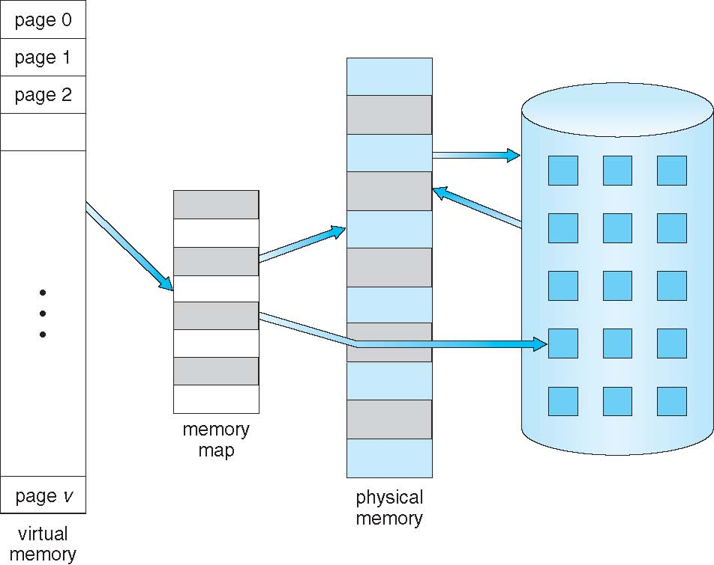
Virtual Memory That is Larger Than Physical Memory

Slide 8
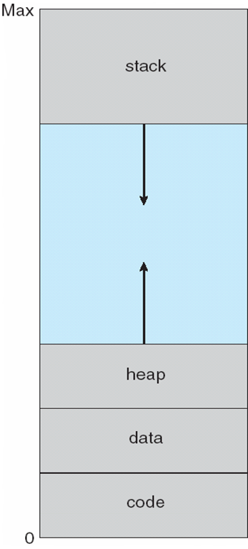
Virtual-address Space
Usually design logical address space for stack to start at Max logical address and grow “down” while heap grows “up”
  Maximizes address space use
  Unused address space between the two is hole
    No physical memory needed until heap or stack grows to a given new page
Enables sparse address spaces with holes left for growth, dynamically linked libraries, etc
System libraries shared via mapping into virtual address space
Shared memory by mapping pages read-write into virtual address space
Pages can be shared during fork(), speeding process creation
Notes:
Stack grows downward => nằm gần địa chỉ logical lớn nhất
Heap grows upward
Unused gap giữa stack và heap không chiếm memory => sparse address spaces, dynamically linked libraries, shared libraries, shared memory, and pagesharing during fork()
- Virtual memory separates logical memory from physical memory.
- Only part of a program needs to be in RAM to execute.
- Logical address space can be larger than physical memory.
- MMU maps virtual/logical addresses to physical addresses.
- Heap grows upward; stack grows downward.
- Unused virtual-address gaps do not require physical memory until needed.

Slide 9
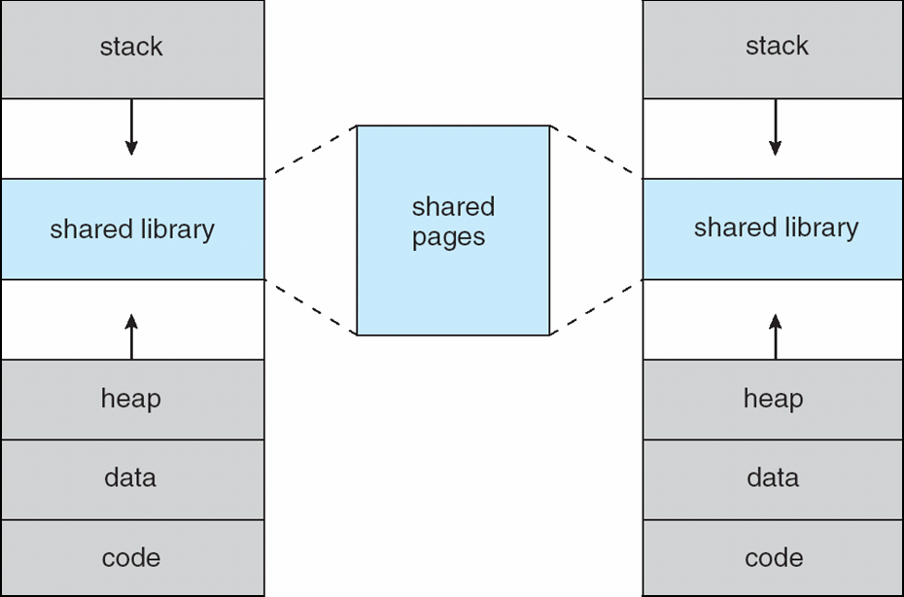
Shared Library Using Virtual Memory

Slide 10
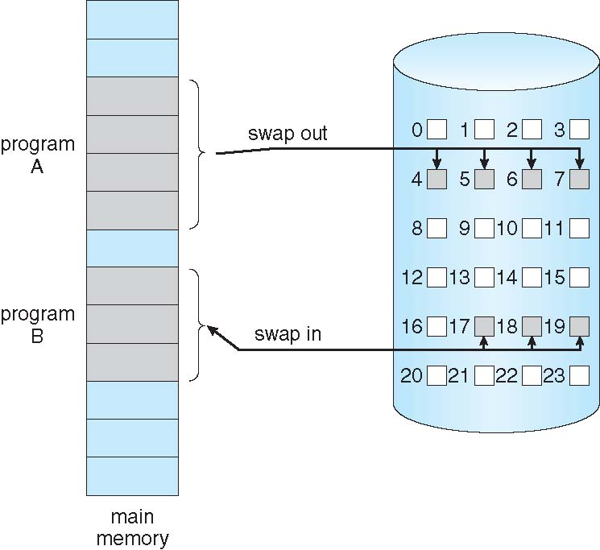
Demand Paging
Could bring entire process into memory at load time
Or bring a page into memory only when it is needed
  Less I/O needed, no unnecessary I/O
  Less memory needed
  Faster response
  More users
Similar to paging system with swapping (diagram on right)
Page is needed ⇒ reference to it
  invalid reference ⇒ abort
  not-in-memory ⇒ bring to memory
Lazy swapper – never swaps a page into memory unless page will be needed
  Swapper that deals with pages is a pager
Notes:
Demand paging: chỉ load 1 page vào RAM khi page đó cần đến
Lazy swapper: chưa cần thì chưa swap

Slide 11
Basic Concepts
With swapping, pager guesses which pages will be used before swapping out again
Instead, pager brings in only those pages into memory
How to determine that set of pages?
  Need new MMU functionality to implement demand paging
If pages needed are already memory resident
  No difference from non demand-paging
If page needed and not memory resident
  Need to detect and load the page into memory from storage
    Without changing program behavior
    Without programmer needing to change code

Slide 12
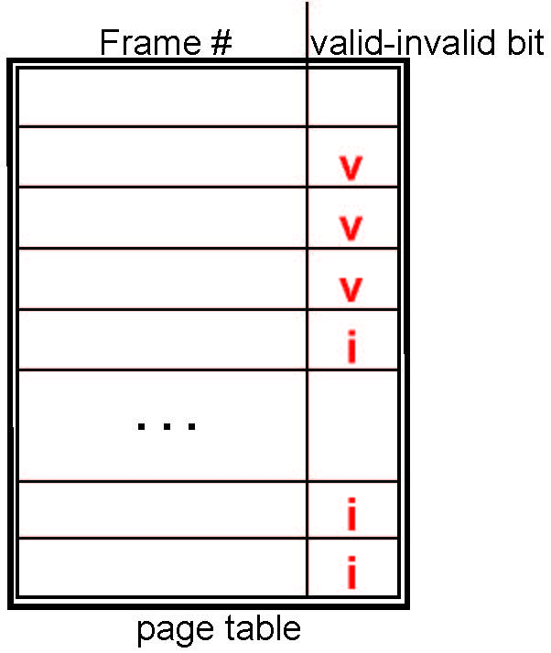
Valid-Invalid Bit
With each page table entry a valid–invalid bit is associated
(v ⇒ in-memory – memory resident, i ⇒ not-in-memory)
Initially valid–invalid bit is set to i on all entries
Example of a page table snapshot:
During MMU address translation, if valid–invalid bit in page table entry is i ⇒ page fault
Notes:
v → page is in memory
i → page is not in memory

Slide 13
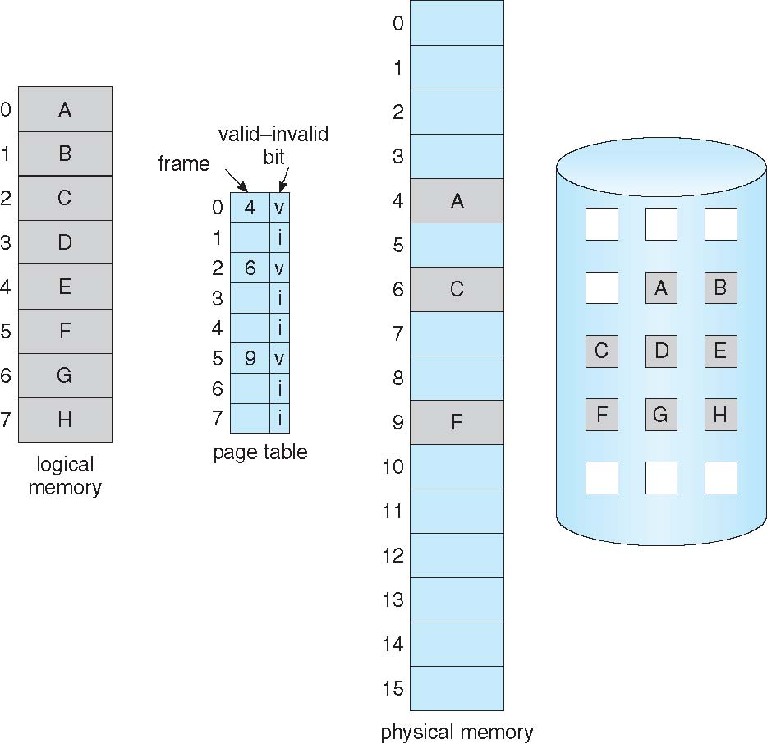
Page Table When Some Pages Are Not in Main Memory

Slide 14
Page Fault
If there is a reference to a page, first reference to that page will trap to operating system:
page fault
Operating system looks at another table to decide:
  Invalid reference ⇒ abort
  Just not in memory
Find free frame
Swap page into frame via scheduled disk operation
Reset tables to indicate page now in memory
Set validation bit = v
Restart the instruction that caused the page fault
Notes:
Page fault xảy ra khi CPU cần một page nhưng page đó chưa nằm trong RAM.
Nhưng i có thể có 2 ý nghĩa:
Page đó hợp lệ, chỉ là chưa nằm trong RAM.
CPU đang truy cập một địa chỉ không hợp lệ đối với process.
Vì vậy OS phải kiểm tra.

Slide 15
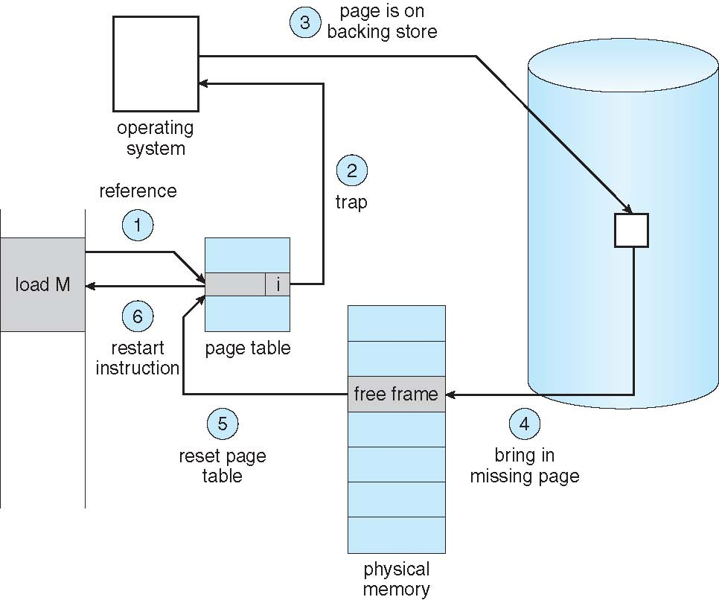
Steps in Handling a Page Fault
Notes:
1. We check an internal table (usually kept with the process control block)
for this process to determine whether the reference was a valid or an
invalid memory access.
2. If the reference was invalid, we terminate the process. If it was valid but
we have not yet brought in that page, we now page it in.
3. Find free frame: We find a free frame (by taking one from the free-frame list, for example).
4. Đọc page từ disk: We schedule a disk operation to read the desired page into the newly
allocated frame.
5. Update page table: When the disk read is complete, we modify the internal table kept with
the process and the page table to indicate that the page is now in memory.
Vd: trước đó Page 2 -> i
Bây giờ, Page 2 -> Frame 2
6. We restart the instruction that was interrupted by the trap. The process
can now access the page as though it had always been in memory.

Slide 16
Aspects of Demand Paging
Extreme case – start process with no pages in memory
  OS sets instruction pointer to first instruction of process, non-memory-resident -> page fault
  And for every other process pages on first access
  Pure demand paging
Actually, a given instruction could access multiple pages -> multiple page faults
  Consider fetch and decode of instruction which adds 2 numbers from memory and stores result back to memory
  Pain decreased because of locality of reference
Hardware support needed for demand paging
  Page table with valid / invalid bit
  Secondary memory (swap device with swap space)
  Instruction restart
Notes:
locality of references is the tendency of a processor to access the same set of memory locations repetitively over a short period of time

Slide 17
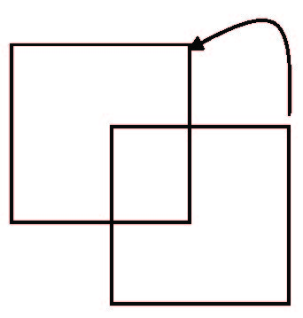
Instruction Restart
Consider an instruction that could access several different locations
  block move
  auto increment/decrement location
  Restart the whole operation?
    What if source and destination overlap?
Notes:
Instruction restart:
- Khi instruction đang chạy mà page fault, OS xử lý page fault xong rồi restart instruction

Slide 18
Performance of Demand Paging
Stages in Demand Paging (worse case)
Trap to the operating system
Save the user registers and process state
Determine that the interrupt was a page fault
Check that the page reference was legal and determine the location of the page on the disk
Issue a read from the disk to a free frame:
  Wait in a queue for this device until the read request is serviced
  Wait for the device seek and/or latency time
  Begin the transfer of the page to a free frame
While waiting, allocate the CPU to some other user
Receive an interrupt from the disk I/O subsystem (I/O completed)
Save the registers and process state for the other user
Determine that the interrupt was from the disk
Correct the page table and other tables to show page is now in memory
Wait for the CPU to be allocated to this process again
Restore the user registers, process state, and new page table, and then resume the interrupted instruction

Slide 19
Performance of Demand Paging (Cont.)
Three major activities
  Service the interrupt – careful coding means just several hundred instructions needed
  Read the page – lots of time
  Restart the process – again just a small amount of time
Page Fault Rate 0 ≤ p ≤ 1
  if p = 0 no page faults
  if p = 1, every reference is a fault
Effective Access Time (EAT)
EAT = (1 – p) x memory access
+ p (page fault overhead
+ swap page out
+ swap page in )

Slide 20
Demand Paging Example
Memory access time = 200 nanoseconds
Average page-fault service time = 8 milliseconds
EAT = (1 – p) x 200 + p (8 milliseconds)
= (1 – p x 200 + p x 8,000,000
= 200 + p x 7,999,800
If one access out of 1,000 causes a page fault, then
EAT = 8.2 microseconds.
This is a slowdown by a factor of 40!!

Slide 21
Demand Paging Example
Memory access time = 200 nanoseconds
Average page-fault service time = 8 milliseconds
EAT = (1 – p) x 200 + p (8 milliseconds)
= (1 – p x 200 + p x 8,000,000
= 200 + p x 7,999,800
If one access out of 1,000 causes a page fault, then
EAT = 8.2 microseconds.
This is a slowdown by a factor of 40!!
If want performance degradation < 10 percent
  220 > 200 + 7,999,800 x p
  20 > 7,999,800 x p
  p < .0000025
  < one page fault in every 400,000 memory accesses

Slide 22
Demand Paging Optimizations
Swap space I/O faster than file system I/O even if on the same device
  Swap allocated in larger chunks, less management needed than file system
Copy entire process image to swap space at process load time
  Then page in and out of swap space
  Used in older BSD Unix
Demand page in from program binary on disk, but discard rather than paging out when freeing frame
  Used in Solaris and current BSD
  Still need to write to swap space
    Pages not associated with a file (like stack and heap) – anonymous memory
    Pages modified in memory but not yet written back to the file system
Mobile systems
  Typically don’t support swapping
  Instead, demand page from file system and reclaim read-only pages (such as code)
Notes:
OS cố gắng làm cho việc đưa page ra vào memory nhanh hơn và tránh đưa xuống disk nếu ko cần
Swap space: vùng trên disk mà OS làm bộ nhớ phụ cho RAM
RAM thiếu chỗ thì OS quyết định “bỏ page này khỏi RAM thì lưu ở đâu”
TH1: page có sẵn trên disk => ko cần đưa vào swap space
TH2: ko có bản gốc như stack heap (dc tạo ra khi ctrinh chạy) => đưa vào swap space

Slide 23
Copy-on-Write
Copy-on-Write (COW) allows both parent and child processes to initially share the same pages in memory
  If either process modifies a shared page, only then is the page copied
COW allows more efficient process creation as only modified pages are copied
In general, free pages are allocated from a pool of zero-fill-on-demand pages
  Pool should always have free frames for fast demand page execution
    Don’t want to have to free a frame as well as other processing on page fault
  Why zero-out a page before allocating it?
vfork() variation on fork() system call has parent suspend and child using copy-on-write address space of parent
  Designed to have child call exec()
  Very efficient
Notes:
Copy on Write:
Sau khi fork(), parent và child dùng chung các page ban đầu nếu chỉ đọc => ko cần copy
Nếu child or parent có sửa page thì copy page mới => copy sang page mới, dữ liệu process kia ko bị sửa
=> nếu copy hết từ đầu thì tốn RAM
Pool of zero out: các dữ liệu trong frame bị xóa và đặt thành 0 => frame sạch để cấp cho process mới
Vfork(): dừng parent process để chạy child process => tránh hỏng dữ liệu vì xài chung

Slide 24
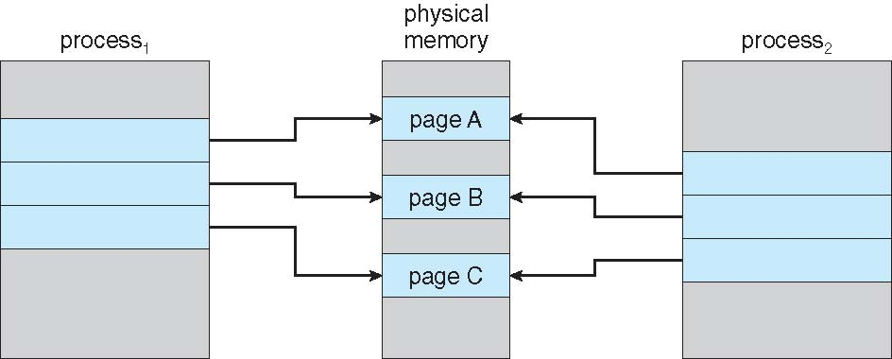
Before Process 1 Modifies Page C

Slide 25
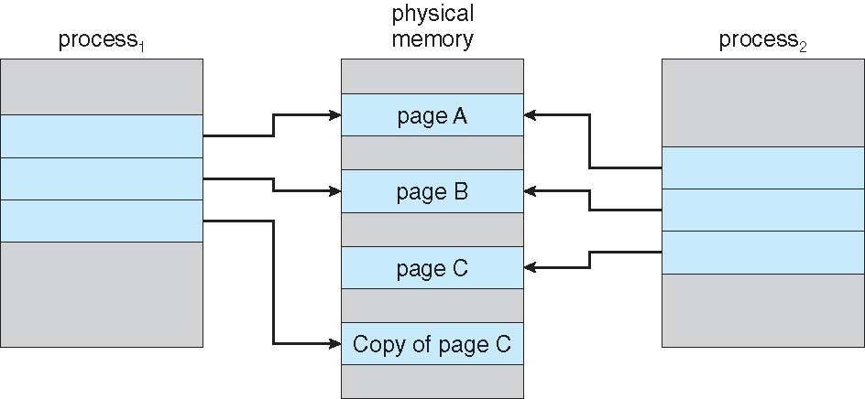
After Process 1 Modifies Page C

Slide 26
What Happens if There is no Free Frame?
Main memory is used up by process pages
Also memory is used in demand from the kernel, I/O buffers, etc
How much to allocate to each?
Page replacement – find some page in memory, but not really in use, page it out
  Algorithm – terminate? swap out? replace the page?
  Performance – want an algorithm which will result in minimum number of page faults
Same page may be brought into memory several times
Notes:
Ko còn free frame thì OS chọn “victim page” để lấy ra khỏi RAM tạo chỗ trống

Slide 27
Page Replacement
Prevent over-allocation of memory by modifying page-fault service routine to include page replacement
Use modify (dirty) bit to reduce overhead of page transfers – only modified pages are written to disk
Page replacement completes separation between logical memory and physical memory – large virtual memory can be provided on a smaller physical memory

Slide 28
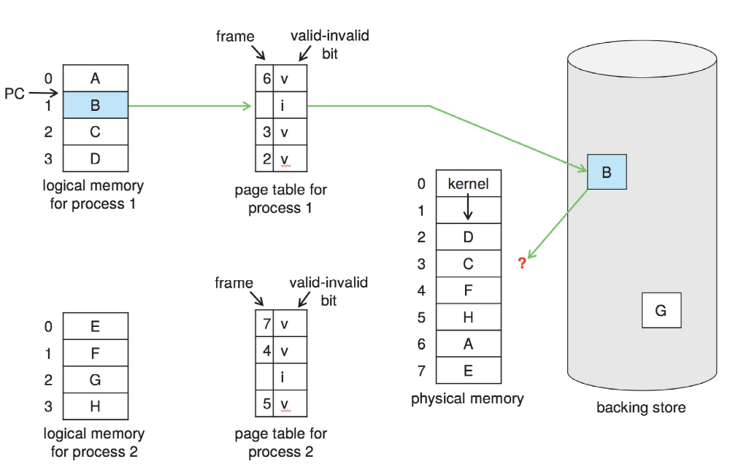
Need For Page Replacement

Slide 29
Basic Page Replacement
Find the location of the desired page on disk
Find a free frame:
- If there is a free frame, use it
- If there is no free frame, use a page replacement algorithm to select a victim frame
- Write victim frame to disk if dirty
Bring the desired page into the (newly) free frame; update the page and frame tables
Continue the process by restarting the instruction that caused the trap
Note now potentially 2 page transfers for page fault – increasing EAT
Notes:
We can reduce this overhead by using a modify bit (or dirty bit). When this
scheme is used, each page or frame has a modify bit associated with it in the
hardware. The modify bit for a page is set by the hardware whenever any byte
in the page is written into, indicating that the page has been modified. When
we select a page for replacement, we examine its modify bit. If the bit is set
we know that the page has been modified since it was read in from secondary
storage. In this case, we must write the page to storage. If the modify bit is not
set, however, the page has not been modified since itwas read intomemory. In
this case,we need notwrite thememory page to storage: it is already there. This
technique also applies to read-only pages (for example, pages of binary code).
Such pages cannot be modified; thus, they may be discarded when desired.
This scheme can significantly reduce the time required to service a page fault,
since it reduces I/O time by one-half if the page has not been modified.

Slide 30
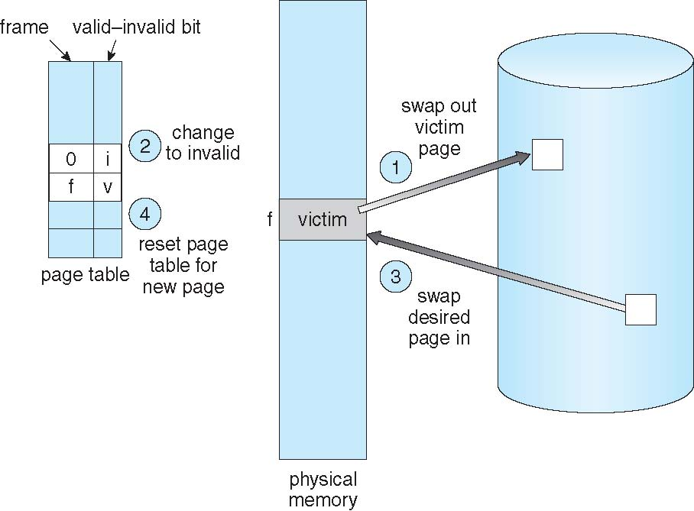
Page Replacement

Slide 31
Page and Frame Replacement Algorithms
Frame-allocation algorithm determines
  How many frames to give each process
  Which frames to replace
Page-replacement algorithm
  Want lowest page-fault rate on both first access and re-access
Evaluate algorithm by running it on a particular string of memory references (reference string) and computing the number of page faults on that string
  String is just page numbers, not full addresses
  Repeated access to the same page does not cause a page fault
  Results depend on number of frames available
In all our examples, the reference string of referenced page numbers is
7,0,1,2,0,3,0,4,2,3,0,3,0,3,2,1,2,0,1,7,0,1
Notes:
Frame allocation: Ví dụ RAM có 10 frames, có 2 process:
P1 được 6 frames
P2 được 4 frames
Page-replacement algorithm:
Khi RAM đầy mà có page fault(cpu cần page mà ram ko có) => OS phải chọn 1 page đẩy ra
Vd: FIFO có thể chọn page 1
RAM đang có:
Page 1
Page 2
Page 3
CPU cần Page 4
Reference string:
chuỗi các page number mà process truy cập theo thứ tự
Reference: nghĩa là process truy cập tới page

Slide 32
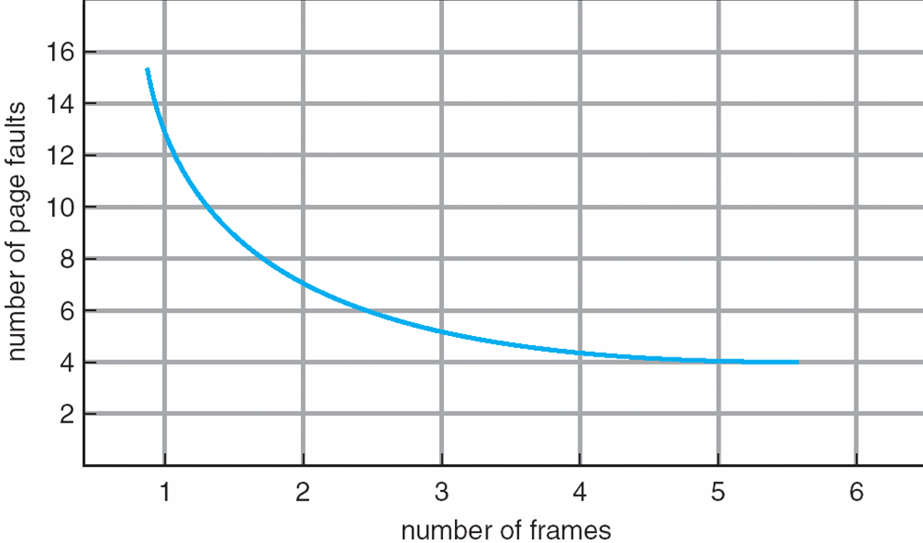
Graph of Page Faults Versus The Number of Frames

Slide 33
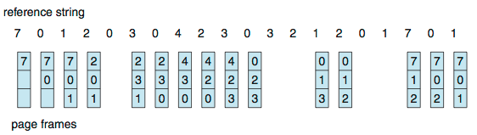
First-In-First-Out (FIFO) Algorithm
Reference string: 7,0,1,2,0,3,0,4,2,3,0,3,0,3,2,1,2,0,1,7,0,1
3 frames (3 pages can be in memory at a time per process)
Can vary by reference string: consider 1,2,3,4,1,2,5,1,2,3,4,5
  Adding more frames can cause more page faults!
    Belady’s Anomaly
How to track ages of pages?
  Just use a FIFO queue
15 page faults
Notes:
FIFO có thể khiến xảy ra page fault

Slide 34
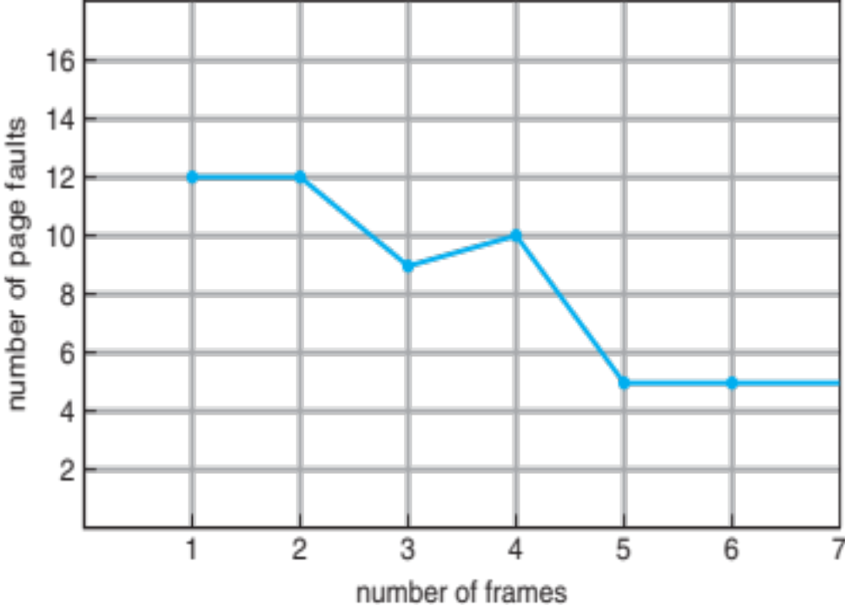
FIFO Illustrating Belady’s Anomaly

Slide 35
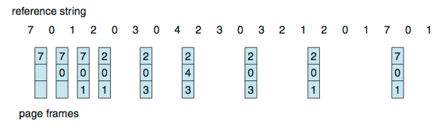
Optimal Algorithm
Replace page that will not be used for longest period of time
  9 is optimal for the example
How do you know this?
  Can’t read the future
Used for measuring how well your algorithm performs
Notes:
OPT chọn page nào ít dùng nhất thì replace page đó:
Ví dụ:
RAM có [1, 2 , 3]
Reference string là: 2,4,1,5,3
Page 1 và 2 trong RAM sẽ dùng lại sớm
Page 3 lâu lắm mới dùng nên replace
Reduce page fault
Vấn đề là OS không biết tương lai

Slide 36
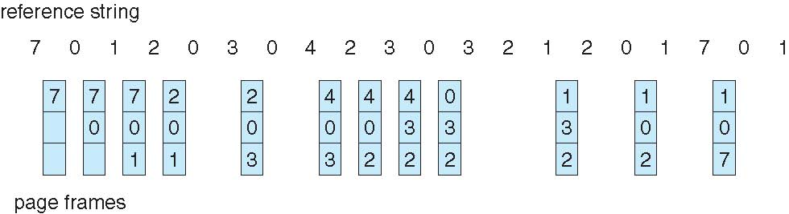
Least Recently Used (LRU) Algorithm
Use past knowledge rather than future
Replace page that has not been used in the most amount of time
Associate time of last use with each page
12 faults – better than FIFO but worse than OPT
Generally good algorithm and frequently used
But how to implement?
Notes:
Khác OPT
OPT nhìn về tương lai
LRU nhìn về quá khứ

Slide 37
LRU Algorithm (Cont.)
Implementation1: Counter implementation
  Every page entry has a counter; every time page is referenced through this entry, copy the clock into the counter
  When a page needs to be changed, look at the counters to find smallest value
    Search through table needed
Implementation2: Stack implementation
  Keep a stack of page numbers in a double link form:
  Page referenced:
    move it to the top
    requires 6 pointers to be changed
  But each update more expensive
  No search for replacement
LRU and OPT are cases of stack algorithms that don’t have Belady’s Anomaly
Notes:
Được implement 2 cách:
Counter (đếm timestamp): mỗi lần page access thì ghi lại thời gian
Page 1 → timestamp 100
Page 2 → timestamp 25
Page 3 → timestamp 90
Timestamp nhỏ nhất thì lâu nhất chưa từng dùng
2) Stack: mỗi lần page access thì đưa page lên đầu
=> Page cuối lâu nhất chưa dùng

Slide 38
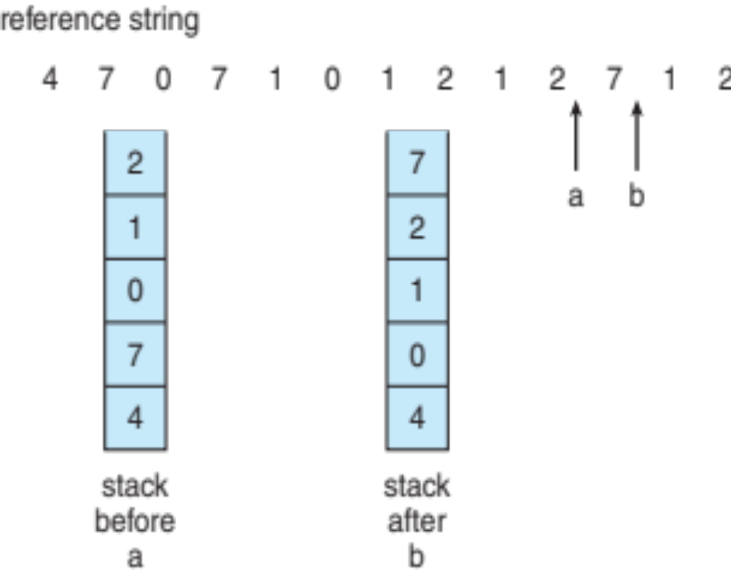
Use Of A Stack to Record Most Recent Page References

Slide 39
LRU Approximation Algorithms
LRU needs special hardware and still slow
Reference bit
  With each page associate a bit, initially = 0
  When page is referenced bit set to 1
  Replace any with reference bit = 0 (if one exists)
    We do not know the order, however
Second-chance algorithm
  Generally FIFO, plus hardware-provided reference bit
  Clock replacement
  If page to be replaced has
    Reference bit = 0 -> replace it
    reference bit = 1 then:
      set reference bit 0, leave page in memory
      replace next page, subject to same rules

Slide 40
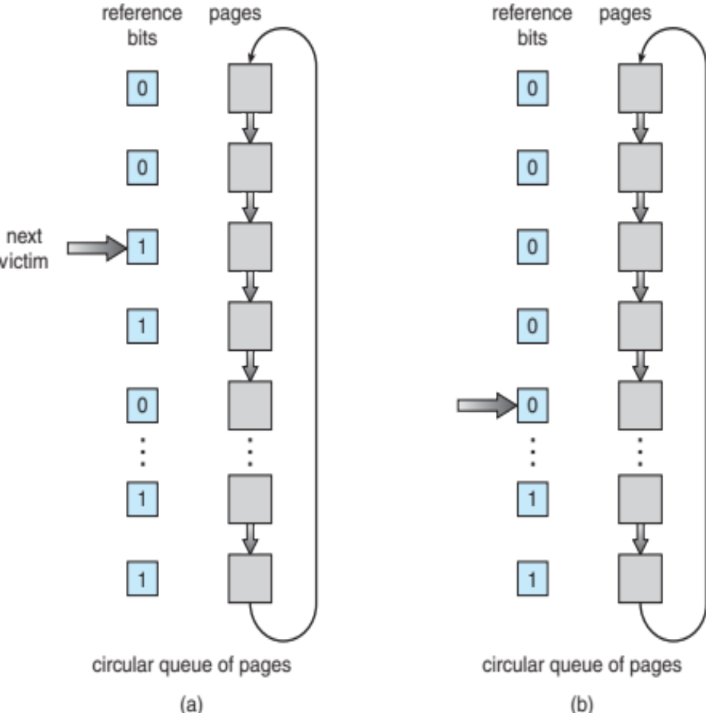
Second-Chance (clock) Page-Replacement Algorithm

Slide 41
Enhanced Second-Chance Algorithm
Improve algorithm by using reference bit and modify bit (if available) in concert
Take ordered pair (reference, modify)
(0, 0) neither recently used not modified – best page to replace
(0, 1) not recently used but modified – not quite as good, must write out before replacement
(1, 0) recently used but clean – probably will be used again soon
(1, 1) recently used and modified – probably will be used again soon and need to write out before replacement
When page replacement called for, use the clock scheme but use the four classes replace page in lowest non-empty class
  Might need to search circular queue several times

Slide 42
Counting Algorithms
Keep a counter of the number of references that have been made to each page
  Not common
Lease Frequently Used (LFU) Algorithm: replaces page with smallest count
Most Frequently Used (MFU) Algorithm: based on the argument that the page with the smallest count was probably just brought in and has yet to be used

Slide 43
Page-Buffering Algorithms
Keep a pool of free frames, always
  Then frame available when needed, not found at fault time
  Read page into free frame and select victim to evict and add to free pool
  When convenient, evict victim
Possibly, keep list of modified pages
  When backing store otherwise idle, write pages there and set to non-dirty
Possibly, keep free frame contents intact and note what is in them
  If referenced again before reused, no need to load contents again from disk
  Generally useful to reduce penalty if wrong victim frame selected

Slide 44
Applications and Page Replacement
All of these algorithms have OS guessing about future page access
Some applications have better knowledge – i.e. databases
Memory intensive applications can cause double buffering
  OS keeps copy of page in memory as I/O buffer
  Application keeps page in memory for its own work
Operating system can given direct access to the disk, getting out of the way of the applications
  Raw disk mode
Bypasses buffering, locking, etc

Slide 45
Allocation of Frames
Each process needs minimum number of frames
Example: IBM 370 – 6 pages to handle SS MOVE instruction:
  instruction is 6 bytes, might span 2 pages
  2 pages to handle from
  2 pages to handle to
Maximum of course is total frames in the system
Two major allocation schemes
  fixed allocation
  priority allocation
Many variations

Slide 46
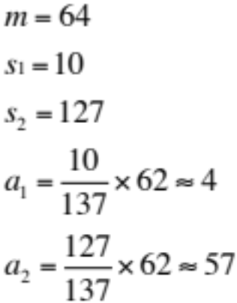
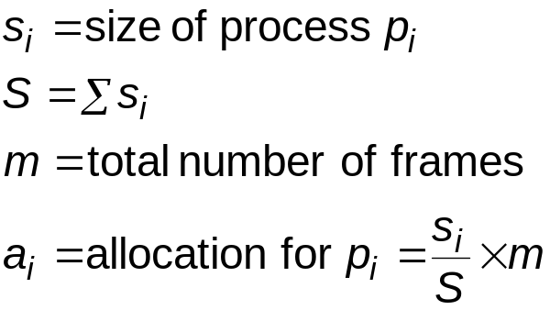
Fixed Allocation
Equal allocation – For example, if there are 100 frames (after allocating frames for the OS) and 5 processes, give each process 20 frames
  Keep some as free frame buffer pool
Proportional allocation – Allocate according to the size of process
  Dynamic as degree of multiprogramming, process sizes change

Slide 47
Priority Allocation
Use a proportional allocation scheme using priorities rather than size
If process P_{i} generates a page fault,
  select for replacement one of its frames
  select for replacement a frame from a process with lower priority number

Slide 48
Global vs. Local Allocation
Global replacement – process selects a replacement frame from the set of all frames; one process can take a frame from another
  But then process execution time can vary greatly
  But greater throughput so more common
Local replacement – each process selects from only its own set of allocated frames
  More consistent per-process performance
  But possibly underutilized memory

Slide 49
Non-Uniform Memory Access
So far all memory accessed equally
Many systems are NUMA – speed of access to memory varies
  Consider system boards containing CPUs and memory, interconnected over a system bus
Optimal performance comes from allocating memory “close to” the CPU on which the thread is scheduled
  And modifying the scheduler to schedule the thread on the same system board when possible
  Solved by Solaris by creating lgroups
    Structure to track CPU / Memory low latency groups
    Used my schedule and pager
    When possible schedule all threads of a process and allocate all memory for that process within the lgroup

Slide 50
Thrashing
If a process does not have “enough” pages, the page-fault rate is very high
  Page fault to get page
  Replace existing frame
  But quickly need replaced frame back
  This leads to:
    Low CPU utilization
    Operating system thinking that it needs to increase the degree of multiprogramming
    Another process added to the system
Thrashing ≡ a process is busy swapping pages in and out

Slide 51
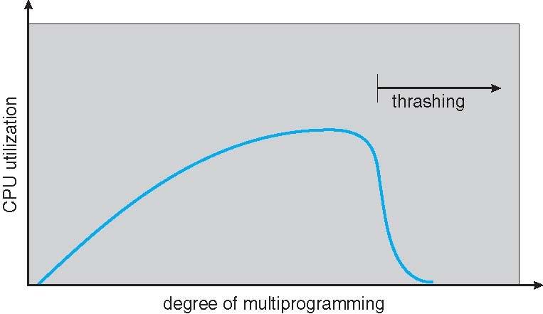
Thrashing (Cont.)

Slide 52
Demand Paging and Thrashing
Why does demand paging work?
Locality model
  Process migrates from one locality to another
  Localities may overlap
Why does thrashing occur?
Σ size of locality > total memory size
  Limit effects by using local or priority page replacement

Slide 53
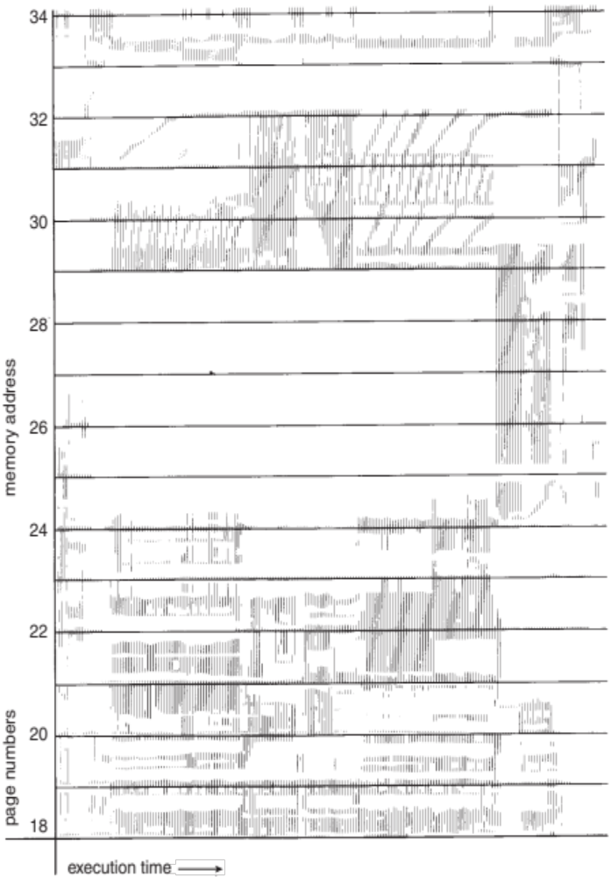
Locality In A Memory-Reference Pattern

Slide 54
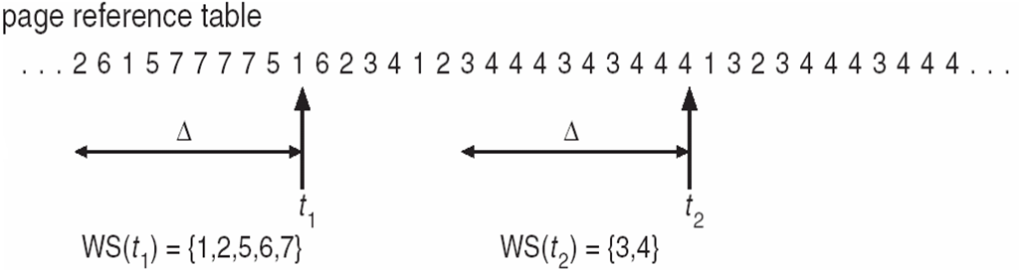
Working-Set Model
Δ ≡ working-set window ≡ a fixed number of page references
Example: 10,000 instructions
WSS_{i} (working set of Process P_{i}) =
total number of pages referenced in the most recent Δ (varies in time)
  if Δ too small will not encompass entire locality
  if Δ too large will encompass several localities
  if Δ = ∞ ⇒ will encompass entire program
D = Σ WSS_{i} ≡ total demand frames
  Approximation of locality
if D > m ⇒ Thrashing
Policy if D > m, then suspend or swap out one of the processes

Slide 55
Keeping Track of the Working Set
Approximate with interval timer + a reference bit
Example: Δ = 10,000
  Timer interrupts after every 5000 time units
  Keep in memory 2 bits for each page
  Whenever a timer interrupts copy and sets the values of all reference bits to 0
  If one of the bits in memory = 1 ⇒ page in working set
Why is this not completely accurate?
Improvement = 10 bits and interrupt every 1000 time units

Slide 56
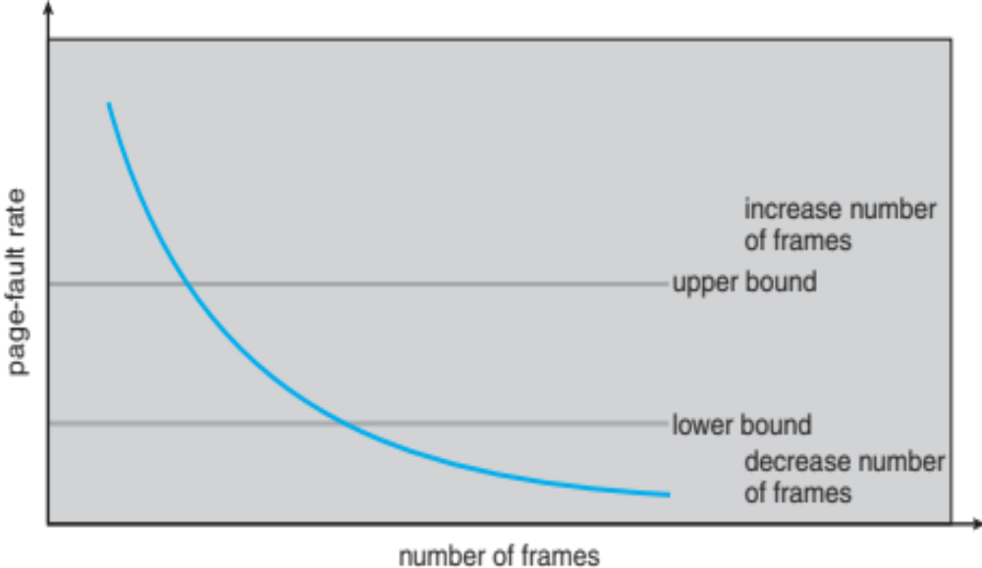
Page-Fault Frequency
More direct approach than WSS
Establish “acceptable” page-fault frequency (PFF) rate and use local replacement policy
  If actual rate too low, process loses frame
  If actual rate too high, process gains frame

Slide 57
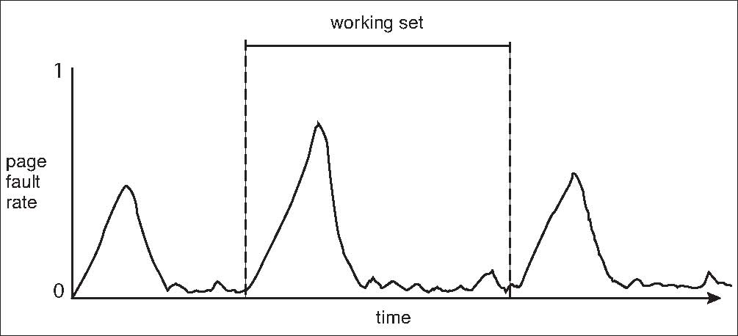
Working Sets and Page Fault Rates
Direct relationship between working set of a process and its page-fault rate
Working set changes over time
Peaks and valleys over time

Slide 58
Memory-Mapped Files
Memory-mapped file I/O allows file I/O to be treated as routine memory access by mapping a disk block to a page in memory
A file is initially read using demand paging
  A page-sized portion of the file is read from the file system into a physical page
  Subsequent reads/writes to/from the file are treated as ordinary memory accesses
Simplifies and speeds file access by driving file I/O through memory rather than read() and write() system calls
Also allows several processes to map the same file allowing the pages in memory to be shared
But when does written data make it to disk?
  Periodically and / or at file close() time
  For example, when the pager scans for dirty pages

Slide 59
Memory-Mapped File Technique for all I/O
Some OSes uses memory mapped files for standard I/O
Process can explicitly request memory mapping a file via mmap() system call
  Now file mapped into process address space
For standard I/O (open(), read(), write(), close()), mmap anyway
  But map file into kernel address space
  Process still does read() and write()
    Copies data to and from kernel space and user space
  Uses efficient memory management subsystem
    Avoids needing separate subsystem
COW can be used for read/write non-shared pages
Memory mapped files can be used for shared memory (although again via separate system calls)

Slide 60
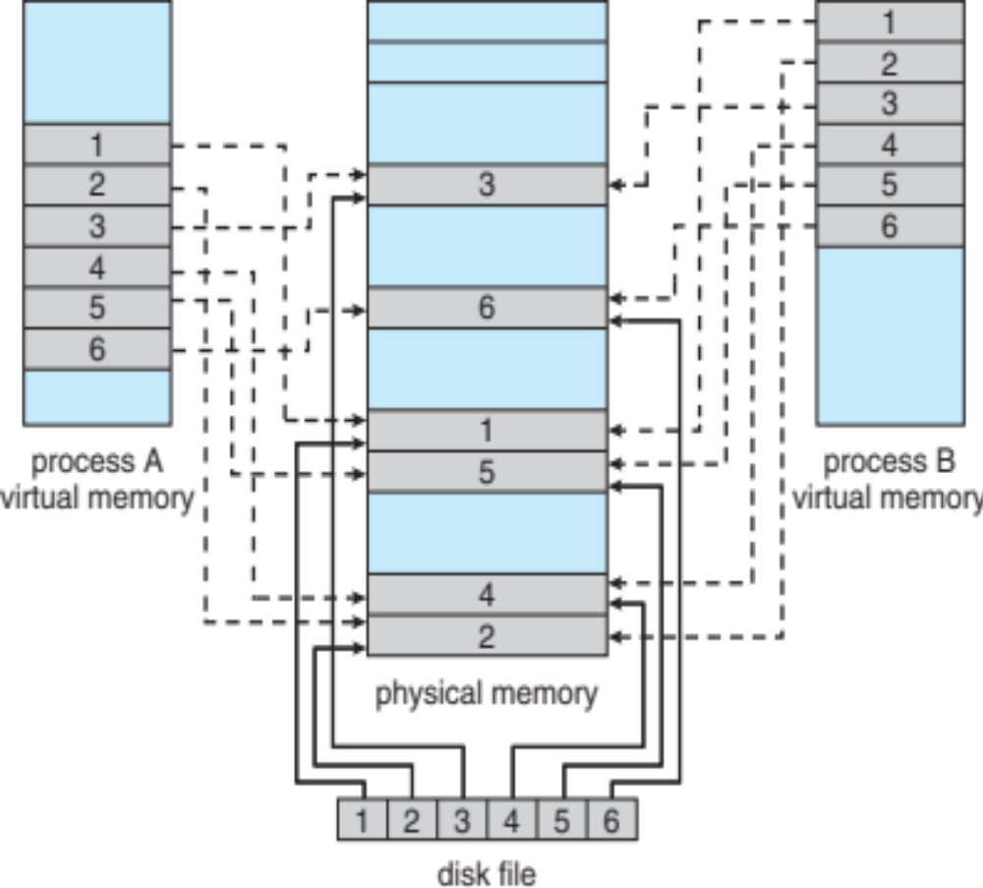
Memory Mapped Files

Slide 61
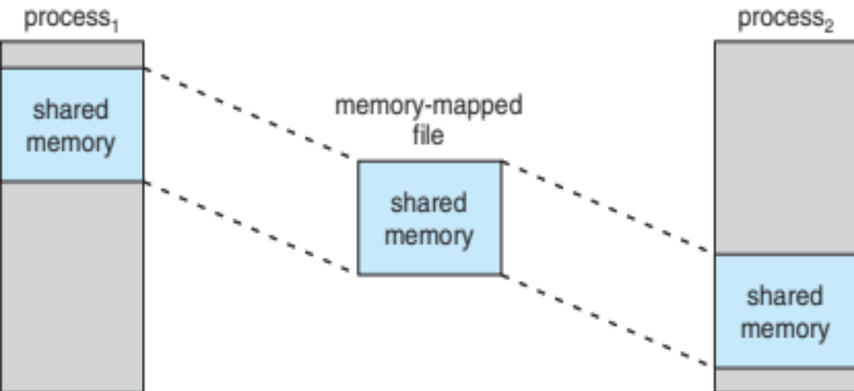
Shared Memory via Memory-Mapped I/O

Slide 62
Shared Memory in Windows API
First create a file mapping for file to be mapped
  Then establish a view of the mapped file in process’s virtual address space
Consider producer / consumer
  Producer create shared-memory object using memory mapping features
  Open file via CreateFile(), returning a HANDLE
  Create mapping via CreateFileMapping() creating a named shared-memory object
  Create view via MapViewOfFile()
Sample code in Textbook

Slide 63
Allocating Kernel Memory
Treated differently from user memory
Often allocated from a free-memory pool
  Kernel requests memory for structures of varying sizes
  Some kernel memory needs to be contiguous
    I.e. for device I/O

Slide 64
Buddy System
Allocates memory from fixed-size segment consisting of physically-contiguous pages
Memory allocated using power-of-2 allocator
  Satisfies requests in units sized as power of 2
  Request rounded up to next highest power of 2
  When smaller allocation needed than is available, current chunk split into two buddies of next-lower power of 2
    Continue until appropriate sized chunk available
For example, assume 256KB chunk available, kernel requests 21KB
  Split into A_{L} _{and} A_{R} of 128KB each
    One further divided into B_{L} and B_{R} of 64KB
      One further into C_{L} and C_{R} of 32KB each – one used to satisfy request
Advantage – quickly coalesce unused chunks into larger chunk
Disadvantage - fragmentation

Slide 65
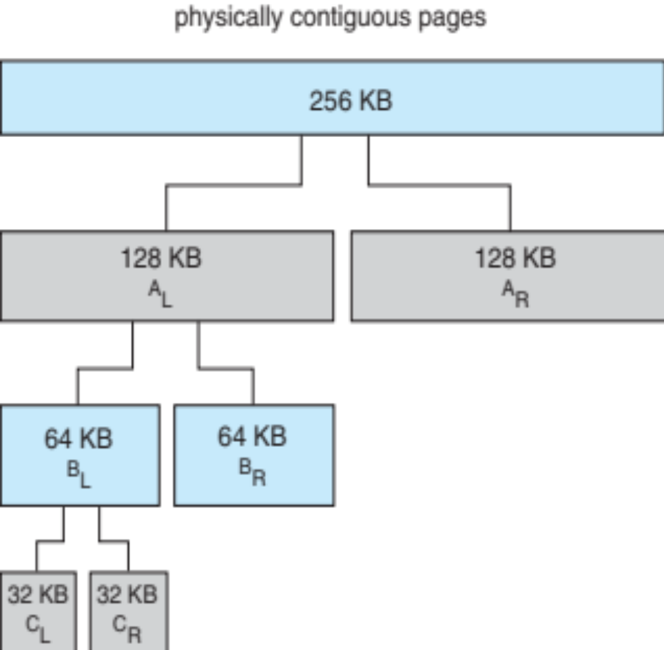
Buddy System Allocator

Slide 66
Slab Allocator
Alternate strategy
Slab is one or more physically contiguous pages
Cache consists of one or more slabs
Single cache for each unique kernel data structure
  Each cache filled with objects – instantiations of the data structure
When cache created, filled with objects marked as free
When structures stored, objects marked as used
If slab is full of used objects, next object allocated from empty slab
  If no empty slabs, new slab allocated
Benefits include no fragmentation, fast memory request satisfaction

Slide 67
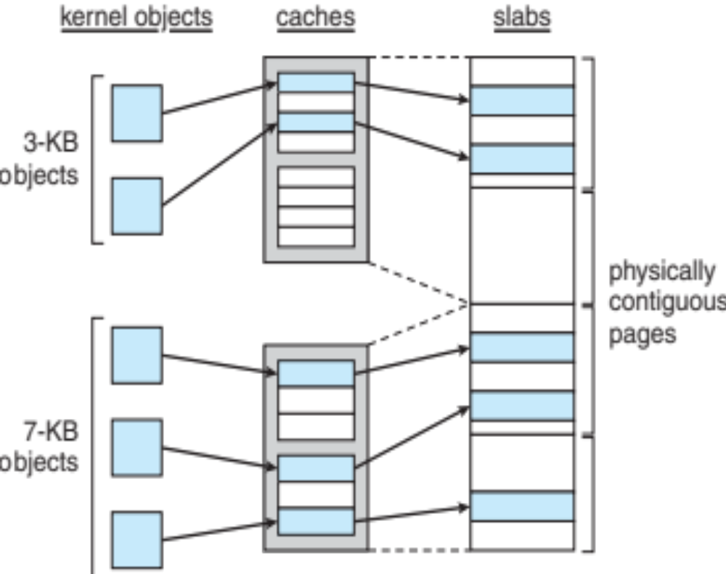
Slab Allocation

Slide 68
Slab Allocator in Linux
For example process descriptor is of type struct task_struct
Approx 1.7KB of memory
New task -> allocate new struct from cache
  Will use existing free struct task_struct
Slab can be in three possible states
  Full – all used
  Empty – all free
  Partial – mix of free and used
Upon request, slab allocator
  Uses free struct in partial slab
  If none, takes one from empty slab
  If no empty slab, create new empty

Slide 69
Slab Allocator in Linux (Cont.)
Slab started in Solaris, now wide-spread for both kernel mode and user memory in various OSes
Linux 2.2 had SLAB, now has both SLOB and SLUB allocators
  SLOB for systems with limited memory
    Simple List of Blocks – maintains 3 list objects for small, medium, large objects
  SLUB is performance-optimized SLAB removes per-CPU queues, metadata stored in page structure

Slide 70
Other Considerations -- Prepaging
Prepaging
  To reduce the large number of page faults that occurs at process startup
  Prepage all or some of the pages a process will need, before they are referenced
  But if prepaged pages are unused, I/O and memory was wasted
  Assume s pages are prepaged and α of the pages is used
    Is cost of s * α save pages faults > or < than the cost of prepaging
    s * (1- α) unnecessary pages?
    α near zero ⇒ prepaging loses

Slide 71
Other Issues – Page Size
Sometimes OS designers have a choice
  Especially if running on custom-built CPU
Page size selection must take into consideration:
  Fragmentation
  Page table size
  Resolution
  I/O overhead
  Number of page faults
  Locality
  TLB size and effectiveness
Always power of 2, usually in the range 2¹² (4,096 bytes) to 2²² (4,194,304 bytes)
On average, growing over time

Slide 72
Other Issues – TLB Reach
TLB Reach - The amount of memory accessible from the TLB
TLB Reach = (TLB Size) X (Page Size)
Ideally, the working set of each process is stored in the TLB
  Otherwise there is a high degree of page faults
Increase the Page Size
  This may lead to an increase in fragmentation as not all applications require a large page size
Provide Multiple Page Sizes
  This allows applications that require larger page sizes the opportunity to use them without an increase in fragmentation

Slide 73
Other Issues – Program Structure
Program structure
  int[128,128] data;
  Each row is stored in one page
  Program 1
for (j = 0; j <128; j++)
for (i = 0; i < 128; i++)
data[i,j] = 0;
  128 x 128 = 16,384 page faults
  Program 2
  for (i = 0; i < 128; i++)
  for (j = 0; j < 128; j++)
  data[i,j] = 0;
  128 page faults

Slide 74
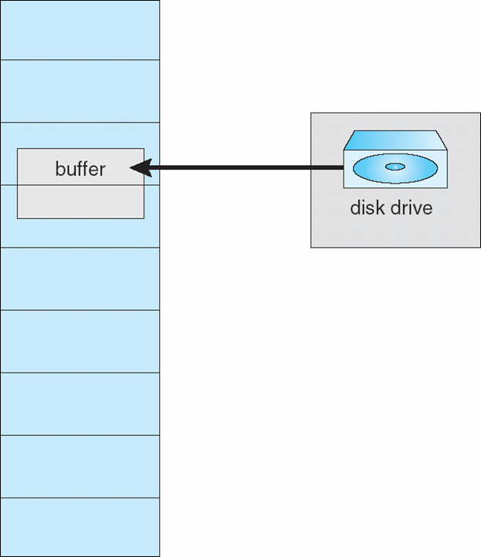
Other Issues – I/O interlock
I/O Interlock – Pages must sometimes be locked into memory
Consider I/O - Pages that are used for copying a file from a device must be locked from being selected for eviction by a page replacement algorithm
Pinning of pages to lock into memory

Slide 75
Operating System Examples
Windows
Solaris

Slide 76
Windows
Uses demand paging with clustering. Clustering brings in pages surrounding the faulting page
Processes are assigned working set minimum and working set maximum
Working set minimum is the minimum number of pages the process is guaranteed to have in memory
A process may be assigned as many pages up to its working set maximum
When the amount of free memory in the system falls below a threshold, automatic working set trimming is performed to restore the amount of free memory
Working set trimming removes pages from processes that have pages in excess of their working set minimum

Slide 77
Solaris
Maintains a list of free pages to assign faulting processes
Lotsfree – threshold parameter (amount of free memory) to begin paging
Desfree – threshold parameter to increasing paging
Minfree – threshold parameter to being swapping
Paging is performed by pageout process
Pageout scans pages using modified clock algorithm
Scanrate is the rate at which pages are scanned. This ranges from slowscan to fastscan
Pageout is called more frequently depending upon the amount of free memory available
Priority paging gives priority to process code pages

Slide 78
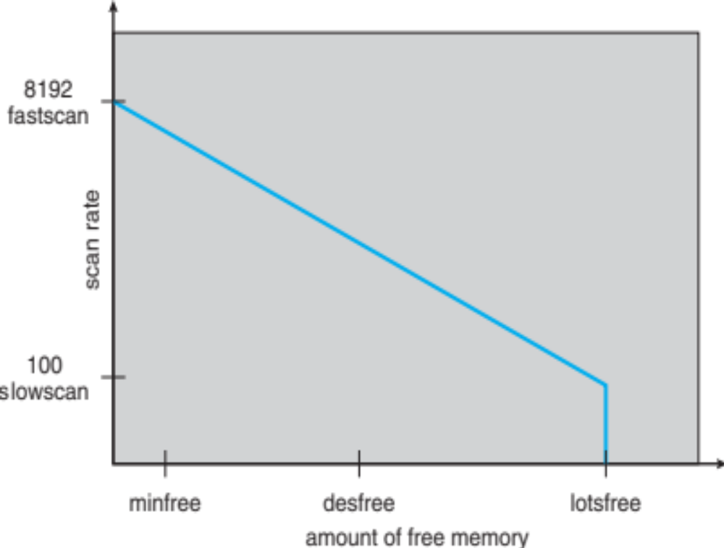
Solaris 2 Page Scanner

Slide 79
End of Chapter 9

